Slide 1
Machine Vision
Project Presentation
“Object Detection & Tracking”
By: Mansoor Ahmad
13th December, 2022

Slide 2
Problem Statement
Detect Individual Objects
Find Contours
Locate Centroid
Identify Shape & Size of Objects
Shapes: Circle, Triangle, Pentagon, Rectangle
Sizes: Small, Medium, Large
Track Individual Object
New Objects Registration
Object Tracking
Object Deletion

Slide 3
Environment Setup - I
Camera Placement
Completely Captures Background
Problem Addressed: extracting ROI
Static Camera
Problem Addressed: constant object area for object size estimation
Perpendicular to Background
Problem Addressed: avoid objects shadows on background
Background
Static Mono Chrome (blue color)
Problem Addressed: easily extract background mask
Glare free
Problem Addressed: no false positive foreground objects
Dark Background
Problem Addressed: Minimize Surrounding Lightening

Slide 4
Environment Setup - II
Objects
Mono Chrome (white color)
Problem Addressed: high contrast b/w foreground & background
Sharpe Edges (straight borders)
Problem Addressed: correctly identify object shape
3 Size per Shape
Problem Addressed: easy to categories & differentiate objects
Flat 2D Shapes
Problem Addressed:
Easy contour detection due to least object shadow
Easy object tracking due to least objects overlap
Constant momentum location

Slide 5
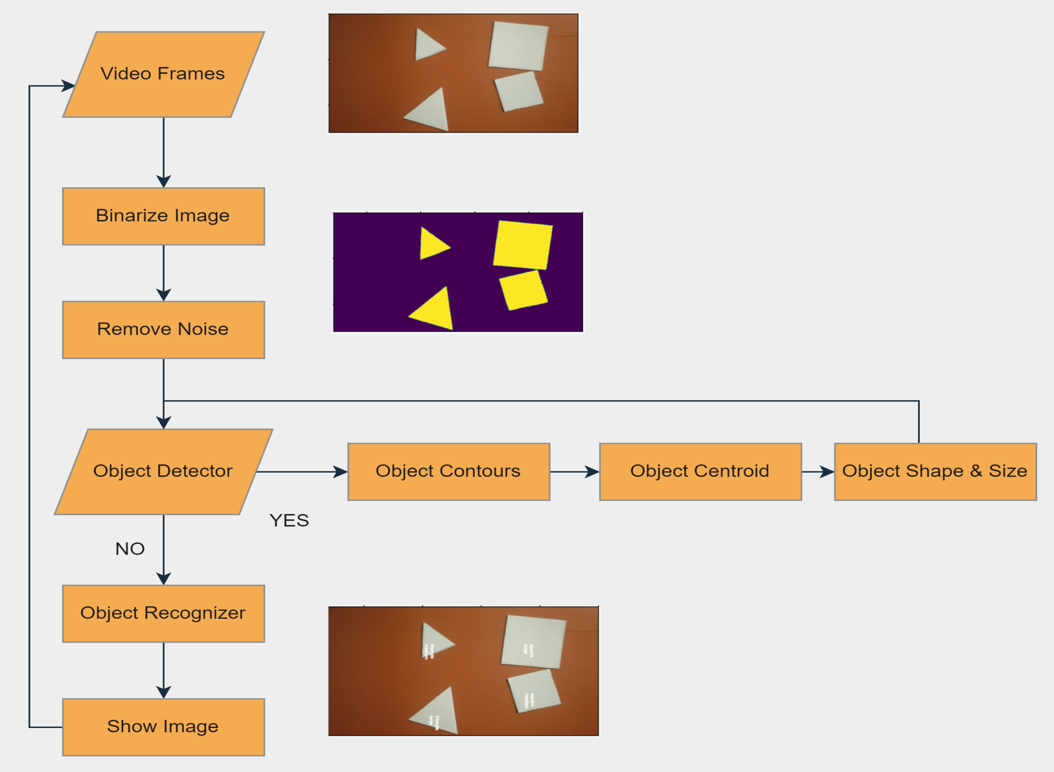
Project Pipeline

Slide 6
Algorithms
Object Detection
Watershed Algorithm (Connected Component Analysis)
Problem Addressed: isolates overlapping object in motion
Shape & Size Identification
ApproxPolyDP (Approximate Number of Edges)
Problem Addressed: object shape recognition without any prior shapes information.
CV Contour Area
Object Tracking
Mean Centroid Tracking (Euclidean Distance)
Distance Threshold: minimum distance b/w any 2 objects
Problem Addressed: avoid hardcoding or strong margins

Slide 7
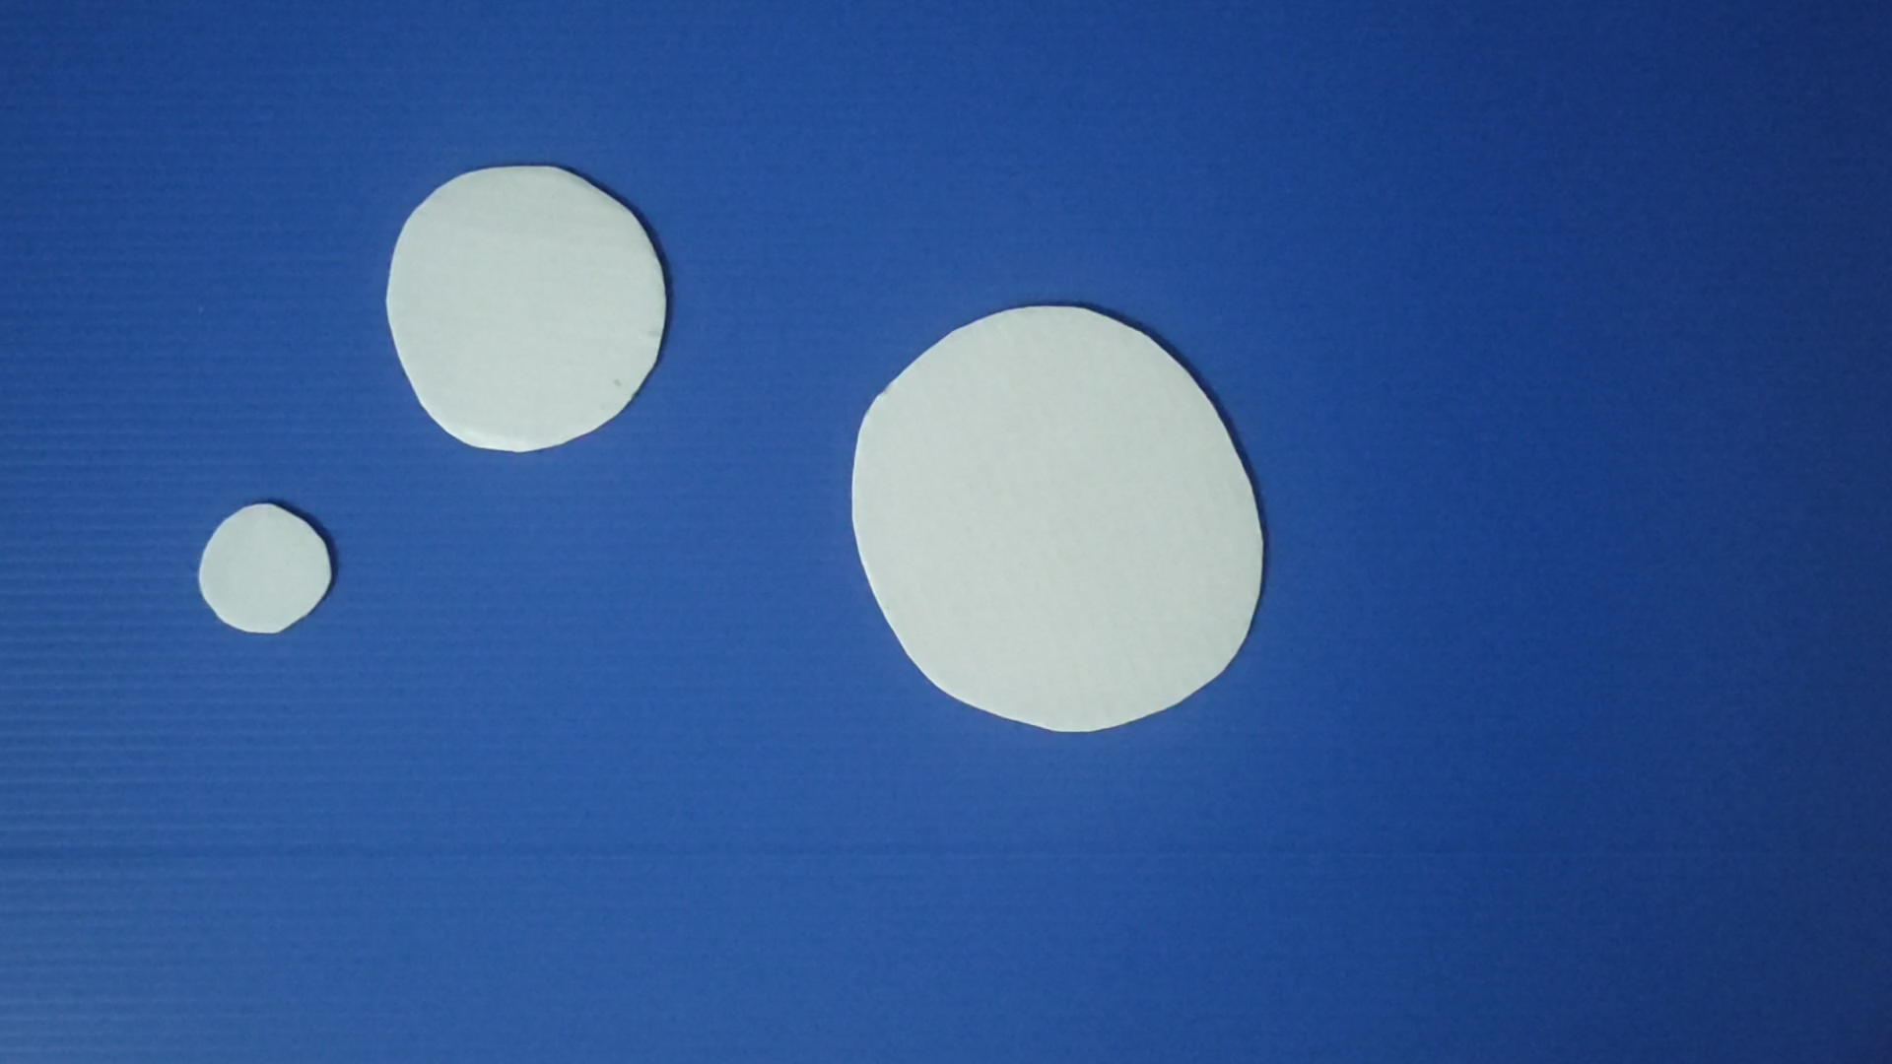
Demo Video

Slide 8
References
https://pyimagesearch.com/2015/11/02/watershed-opencv/
https://docs.opencv.org/4.x/d7/d4d/tutorial_py_thresholding.html
https://pyimagesearch.com/2018/07/23/simple-object-tracking-with-opencv/
https://pyimagesearch.com/2016/02/08/opencv-shape-detection/
https://opencv24-python-tutorials.readthedocs.io/en/latest/py_tutorials/py_imgproc/py_morphological_ops/py_morphological_ops.html

Slide 9
Acknowledgement
Dr. Chayakorn Netramai

